Slide 1
PROJECT ON EDUCATIONAL WEBSITE
By
Akshay Ganesh Adhav
For the year
2022-2023
Under the guidance of
Honey Andani

Slide 2
ABSTRACT
Educational website provide all information regarding our colleges. student can get all information before taking admission in this course. This site provides the all information regarding their syllabus, especially for the training and placement since it is difficult to get the students informed during the campus so all the students can easily get information on website

Slide 3
Scope of system:
It also help in current all works related to educational website.
This web site is being developed for college and is intended to used by individuals with web access.
This is also very useful for faculty and students of b.voc course
This web sit is important to inform student about B.voc course information

Slide 4
Advantages
Student can assess there course at any time, from any were they can sign up.
You will save time if you have a website link.
Student know how many facility in this course and college have.
You can take online admission through website

Slide 5
Page details
Home page
Facility page
Contact page
About us page
Sign up page
Admission page

Slide 6
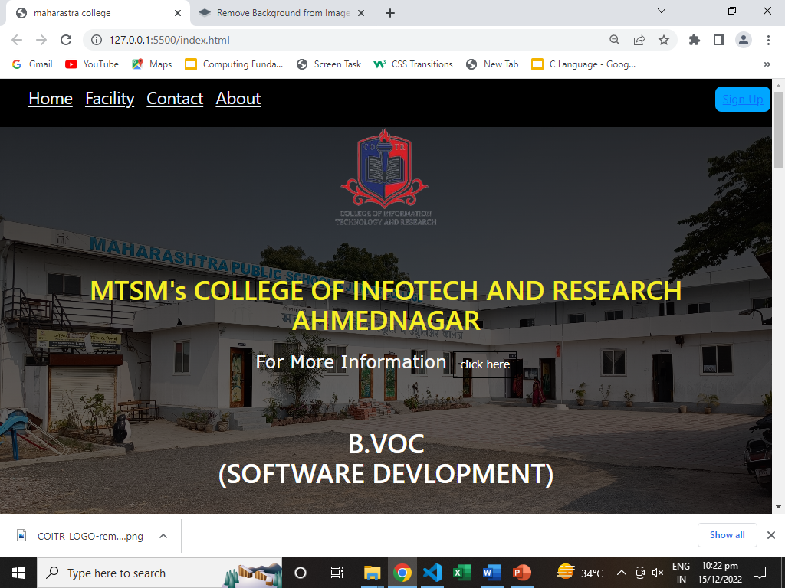
Snapshots of projects
Home Screen:

Slide 7
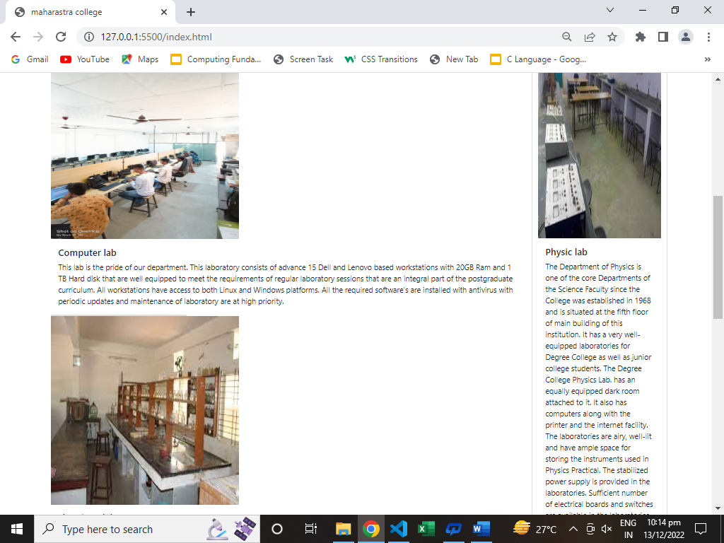

Slide 8
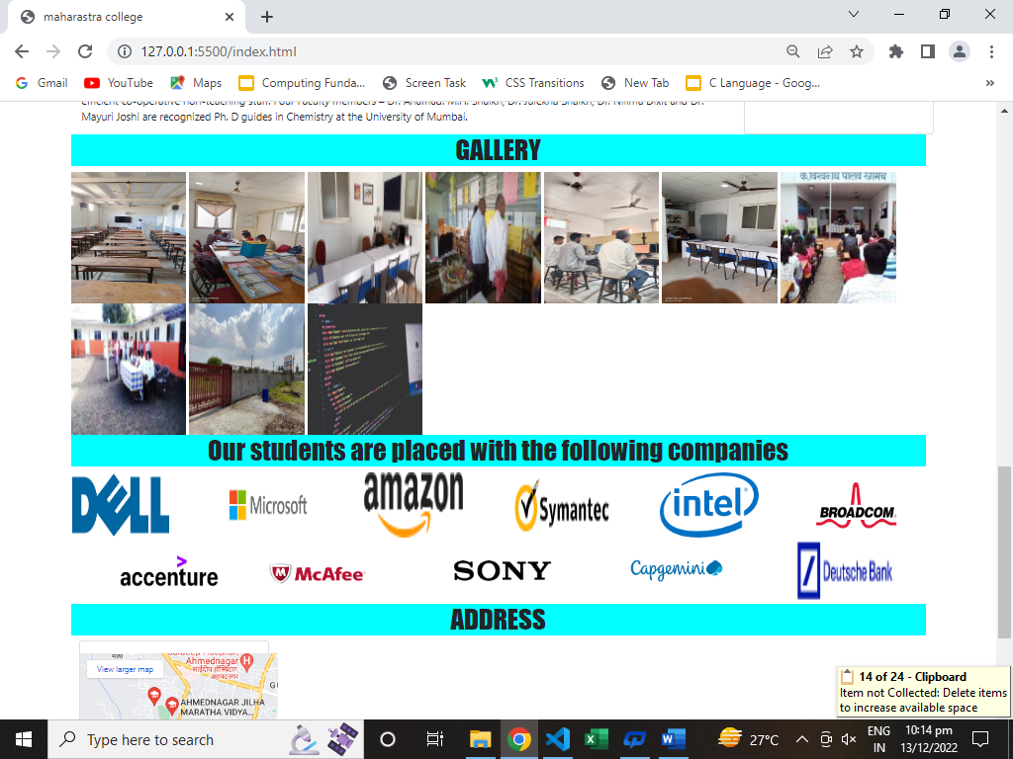

Slide 9
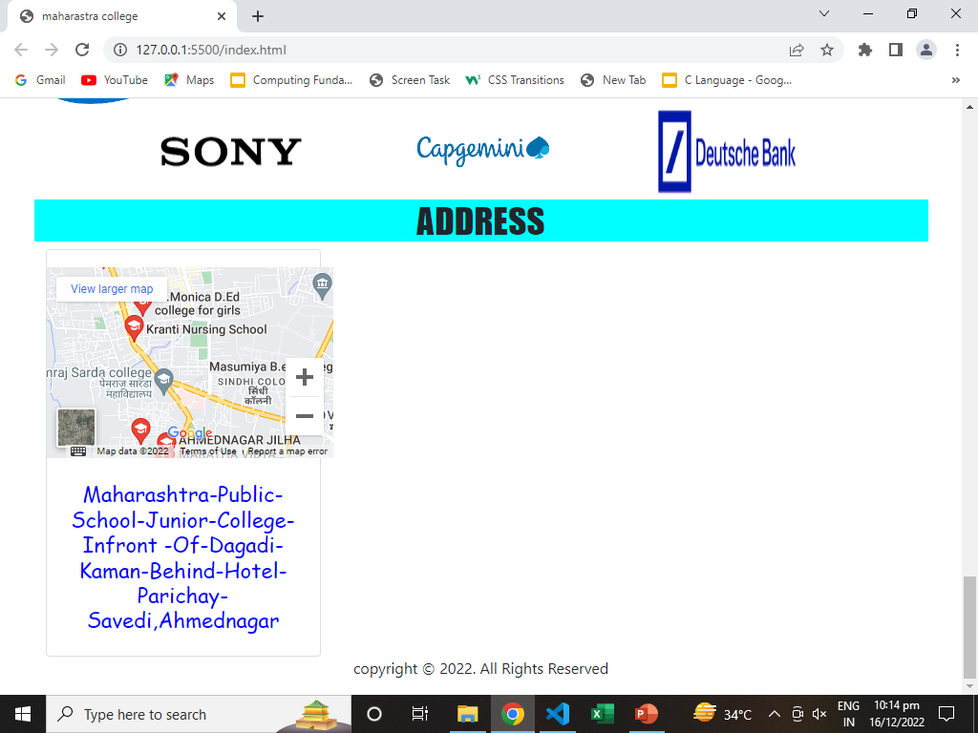

Slide 10
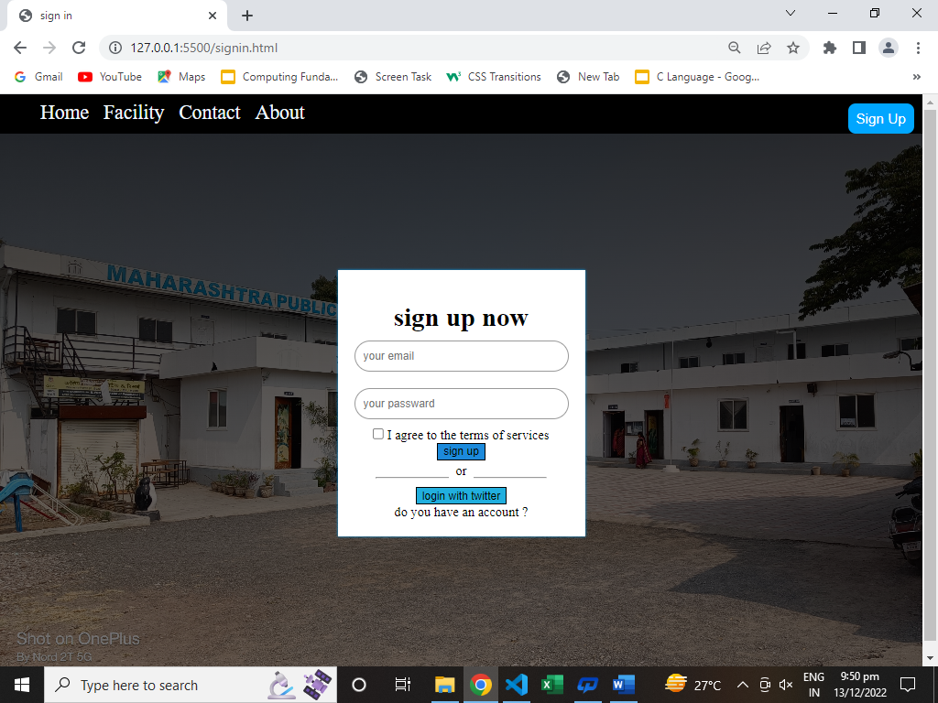
Sign up page:

Slide 11
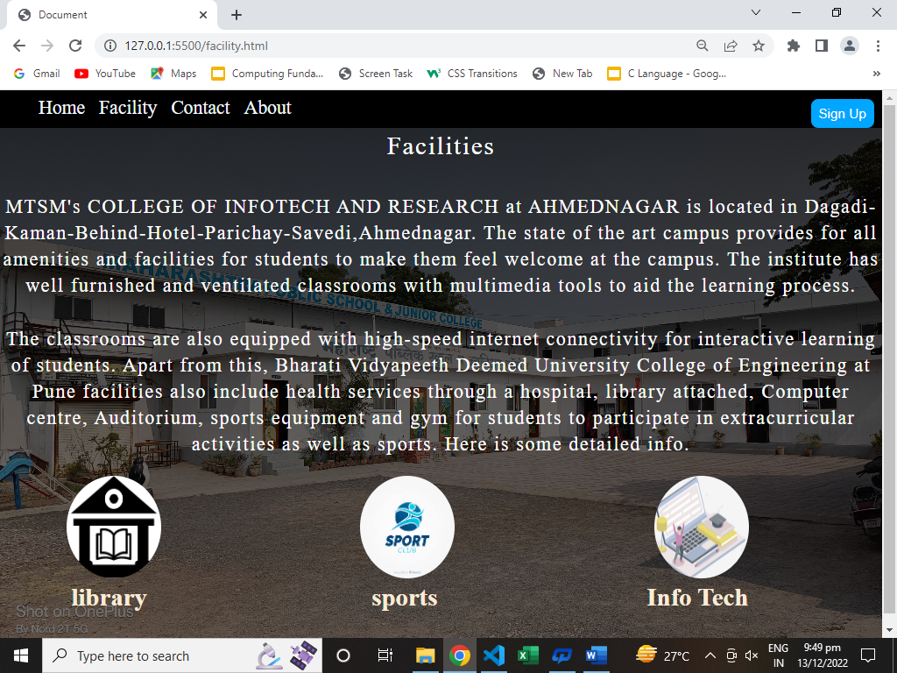
Facility page:

Slide 12
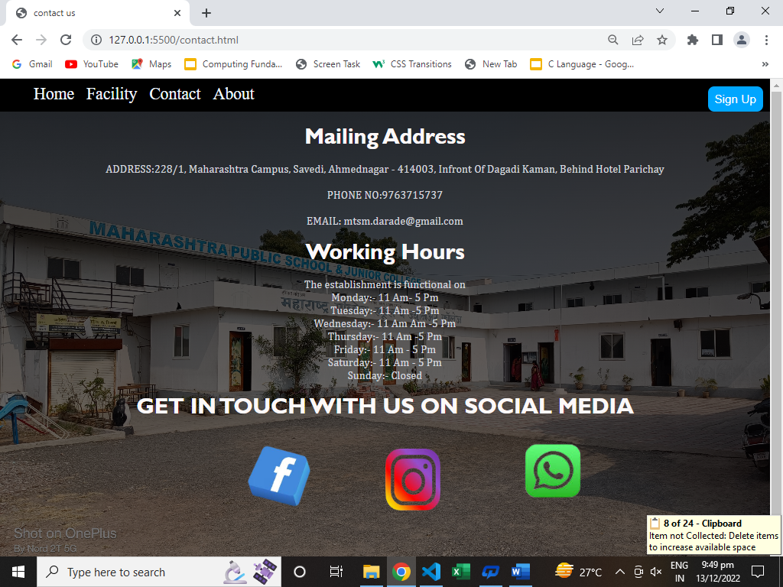
Contact page:

Slide 13
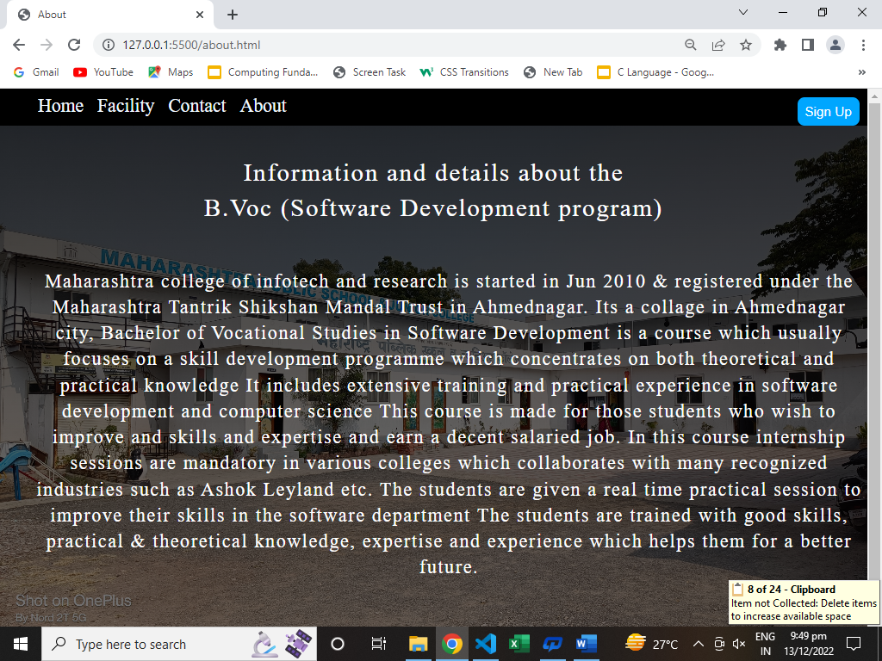
About page:

Slide 14
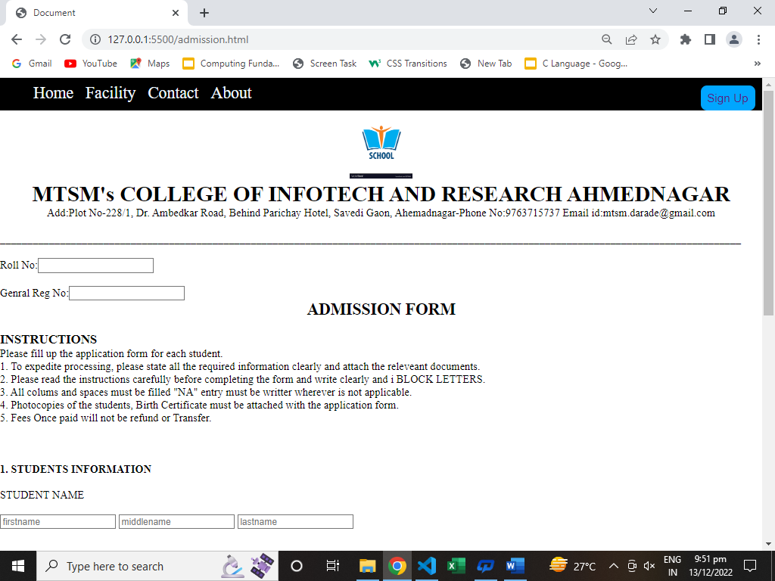
Admission form page:

Slide 15
THANK YOU

